Slide 1
CSS basics
Xbi@eamv

Slide 2
Overview of Cascading Style Sheets (CSS)
See what is possible with CSS:
Visit http://www.csszengarden.com
CSS
provides the functionality of style sheets (and much more) for web developers
a flexible, cross-platform, standards-based language developed by the W3C
https://www.w3.org/

Slide 3
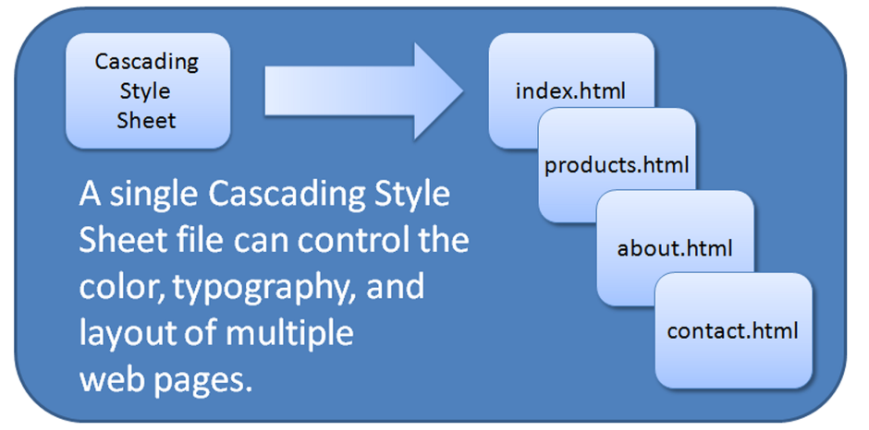
CSS Advantages
Greater typography and page layout control
Style is separate from structure
Styles can be stored in a separate document and associated with many web pages
Potentially smaller documents
Easier site maintenance

Slide 4
Types of Cascading Style Sheets
Inline Styles
Embedded Styles
External Styles
Imported Styles***

Slide 5
Description of the Types of Cascading Style Sheets
Inline Styles
Configured in the body of the web page
Use the style attribute of an HTML tag
Apply only to the specific element
Internal Styles
Configured in the head section of a web page.
Use the HTML <style> element
Apply to the entire web page document
External Styles
Configured in a separate text file with .css file extension
The HTML <link> element in the head section of a web page associates it with the .css file
Imported Styles
Similar to External Styles

Slide 6

Inline CSS with the Style Attribute
Inline CSS
Configured in the body of the Web page
Use the style attribute of an HTML tag
Apply only to the specific element
The Style Attribute
Value: one or more style declaration property and value pairs
Examples
<h1 style="color:#ff0000">Heading text is red</h1>
<h1 style="color:#FF0000;background-color:#cccccc">This is displayed as a red heading with gray background</h1>

Slide 7
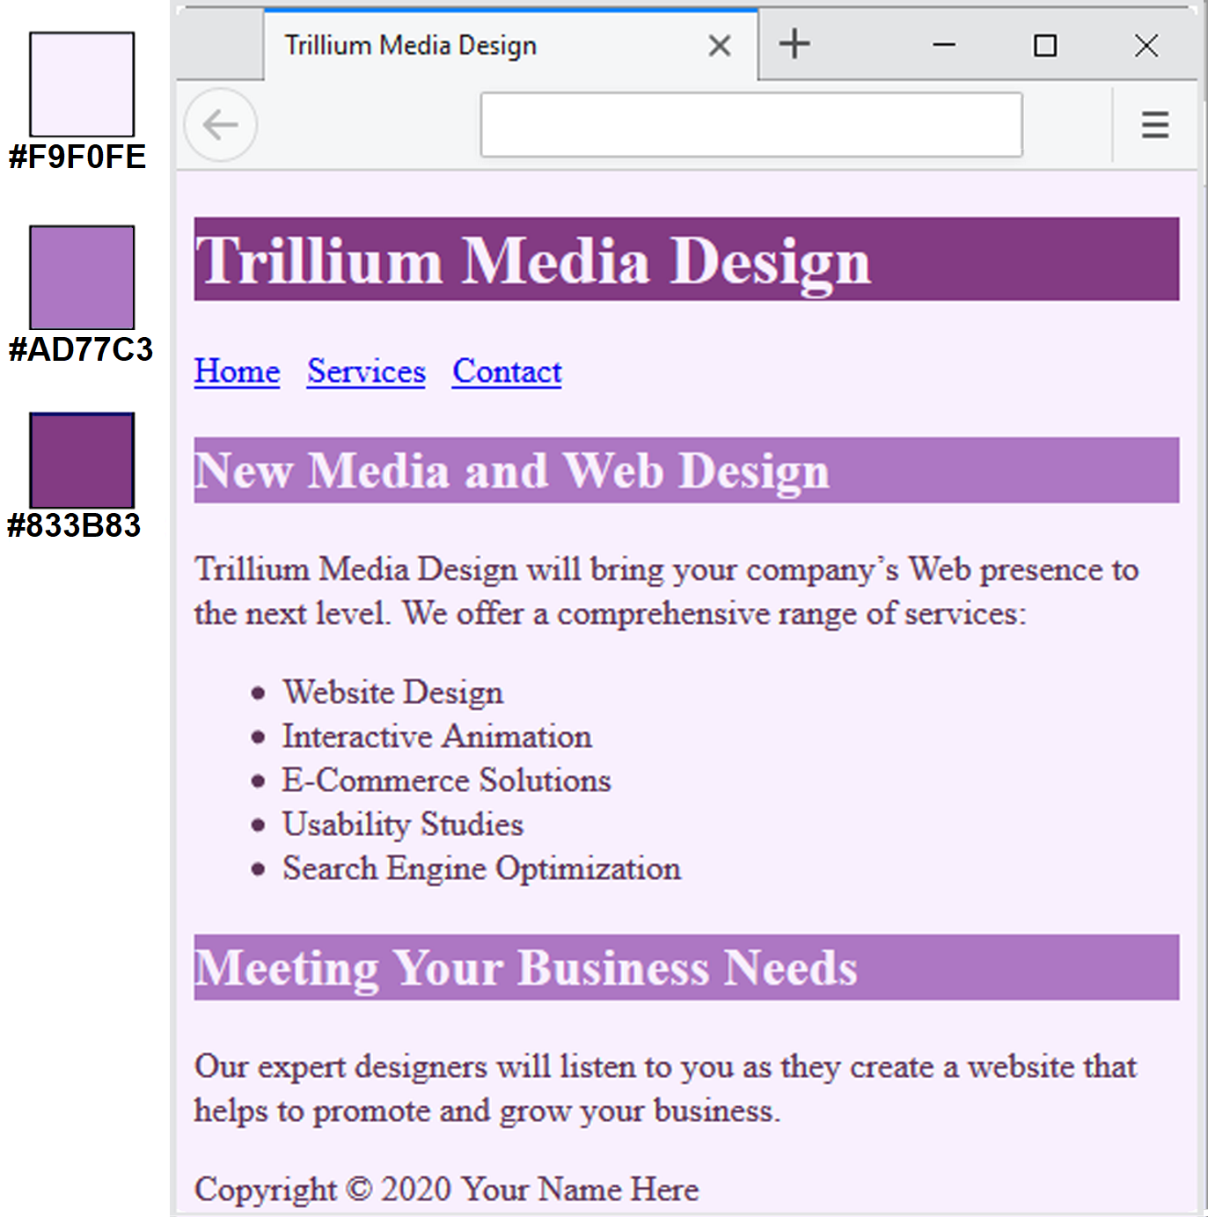
CSS internal Styles
The body selector sets the global style rules for the entire page.
These global rules are overridden for <h1> and <h2> elements by the h1 and h2 style rules.
<style>
body { background-color: #E6E6FA;
color: #191970; }
h1 { background-color: #191970;
color: #E6E6FA; }
h2 { background-color: #AEAED4;
color: #191970; }
</style>

Slide 8
External Style Sheets - 1
CSS style rules are contained in a text file separate from the HTML documents.
The External Style Sheet text file:
extension ".css"
contains only style rules
does not contain any HTML tags

Slide 9
External Style Sheets - 2
Multiple web pages can associate with the same external style sheet file.
index.html
site.css
body { background-color: #E6E6FA;
color: #000000;
}
h2 { color: #003366; }
clients.html
about.html
etc…

Slide 10
The <link> Element
A self-contained tag
Placed in the head section
Purpose: associates the external style sheet file with the web page.
Example:
<link rel="stylesheet" href="color.css">

Slide 11
Using an External Style Sheet
External Style Sheet color.css
body { background-color: #0000FF;
color: #FFFFFF;
}
To associate with the external style sheet called color.css, place the following code in the head section:
<link rel="stylesheet" href="color.css">

Slide 12
Question: inline or internal?
<head>
<style>
body { background-color: red; }
p { margin-left: 20px; }
hr { color: sienna; }
</style>
</head>

Slide 13
Question: which CSS type is below?
<body style="background-color:red;"> ... </body>

Slide 14
question
Which CSS styles did you use for midvejs project?

Slide 15
Demo external and import styles
uge 43 css

Slide 16
Group Discussion
Let's discuss the different use cases and scenarios where inline styles, internal, external stylesheets, and CSS import styles ,which one can be beneficial

Slide 17
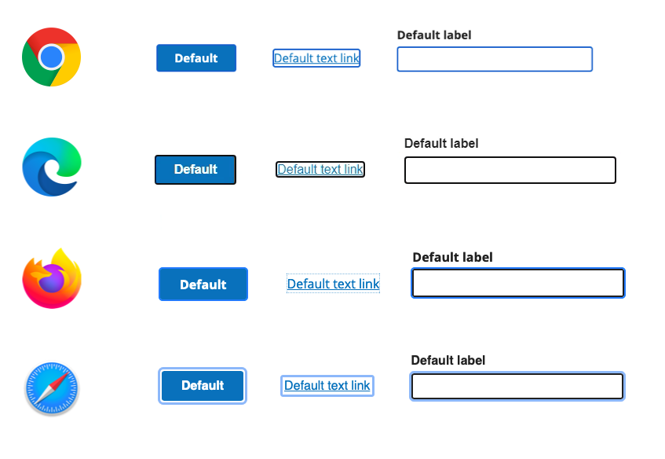
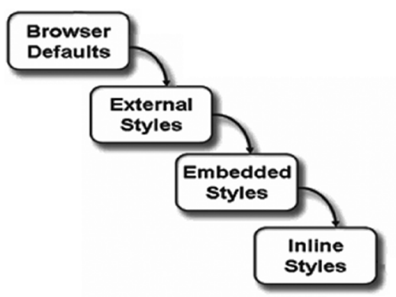
The “Cascade”

Slide 18
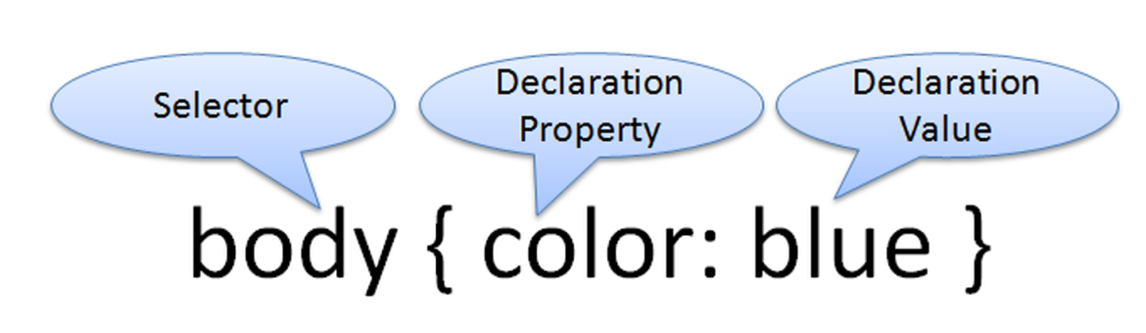
CSS Syntax
Style sheets are composed of "Rules" that describe the styling to be applied.
Each rule contains a Selector and a Declaration

Slide 19
CSS Syntax Sample
Configure a web page to display blue text and yellow background.
body { color: blue;
background-color: yellow; }
This could also be written using hexadecimal color values as shown below.
body { color: #0000FF;
background-color: #FFFF00; }

Slide 20
CSS -- programming paradigm
CSS (Cascading Style Sheets) is primarily based on the declarative programming paradigm rather than procedural or imperative programming paradigms. Declarative programming focuses on describing the desired outcome or result, rather than explicitly specifying step-by-step instructions on how to achieve it

Slide 21
CSS Selectors
Common Types of Selectors:
HTML element name selector
class selector
id selector
descendant selector

Slide 22
CSS Syntax for Color Values
Table 4.2 Syntax to configure a paragraph with red text
CSS Syntax | Color Type
p { color: red } | Color name
p { color: #FF0000 } | Hexadecimal color value
p { color: #F00 } | Shorthand hexadecimal (one character for each hexadecimal pair – only used with web safe colors)
p { color: rgb(255,0,0) } | Decimal color value (RGB triplet)
p { color: rgba(255,0,0,0.5) } | Decimal color value (RGB triplet) followed by the alpha opacity (a value from 0 to 1).
p { color: hsl(0, 100%, 50%) } | HSL color values.

Slide 23
Using CSS with “class”
class Selector
Apply a CSS rule to ONE OR MORE elements on a web page
Does not associate the style to a particular HTML element
Configure with . classname
The sample creates a class called “new” with red italic text.
To use the class, code the following HTML:
<p class="new">This text is red</p>
<style>
.new { color: #FF0000;
}
</style>

Slide 24
Uge 44

Slide 25
Using a CSS id Selector
id Selector
Apply a CSS rule to ONLY ONE element on a web page.
Configure with #idname
The sample creates an id called “new” with red, large, italic text.
To use the id, code the following HTML:
<p id="new">This text is red.</p>
<style>
#new { color: #FF0000;
}
</style>

Slide 26
Using a CSS Descendant Selector
Descendant Selector
Apply a CSS rule within the context of the container (parent) element.
Sometimes called a contextual selector.
The sample specifies a green text color for only the paragraph elements located within the footer element.
<style>
footer p { color: #00FF00; }
</style>

Slide 27
Exercise explain other css selectors
CSS Combinators
https://www.w3schools.com/css/css_combinators.asp
CSS Pseudo-classes
https://www.w3schools.com/css/css_pseudo_classes.asp
Se xbi's demo

Slide 28
HTML Span Element <span>
An inline-level element
Purpose:
Configure a specially formatted area displayed in-line with other elements, such as within a paragraph.
There is no line break before and after the span.

Slide 29
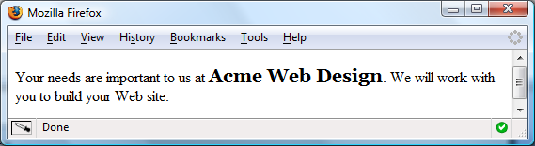
<span> Example
Embedded CSS:
<style>
.companyname { font-weight: bold;
font-family: Georgia, "Times New Roman", serif;
font-size: 1.25em; }
</style>
HTML:
<p>Your needs are important to us at <span class=“companyname">Acme Web Design</span> We will work with you to build your website.</p>

Slide 30
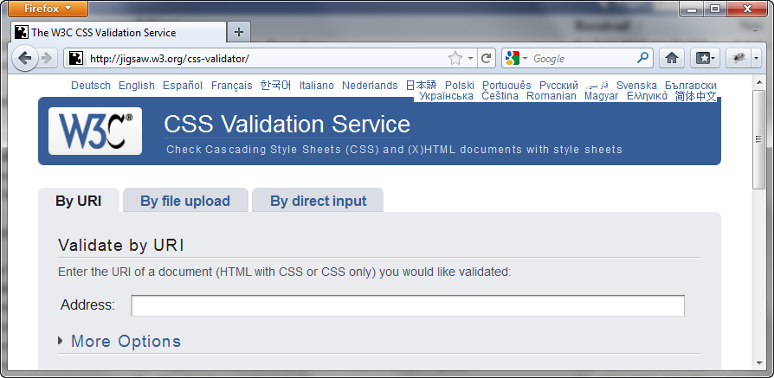
W3C CSS Validation
https://jigsaw.w3.org/css-validator

Slide 31
CSS Troubleshooting Tips
Verify you are using the : and ; symbols in the right spots—they are easy to confuse.
Check that you are using : between each property and its value.
Verify that the { and } symbols are properly placed
Check the syntax of your selectors, their properties, and property values for correct usage.
Validate your CSS at https://jigsaw.w3.org/css-validator

Slide 32
exercises

